Slide 1

World Atlas of Language Structures
Randall Scott Taylor
IST-652
Final Project Presentation
13 March 2020
Notes:
NOTE:
To change the image on this slide, select the picture and delete it. Then click the Pictures icon in the placeholder to insert your own image.

Slide 2
Presentation Topics to be discussed
The data source, and ‘why’ the study
Analysis Questions
Visualizations and Conclusions drawn
Description of the program

Slide 3
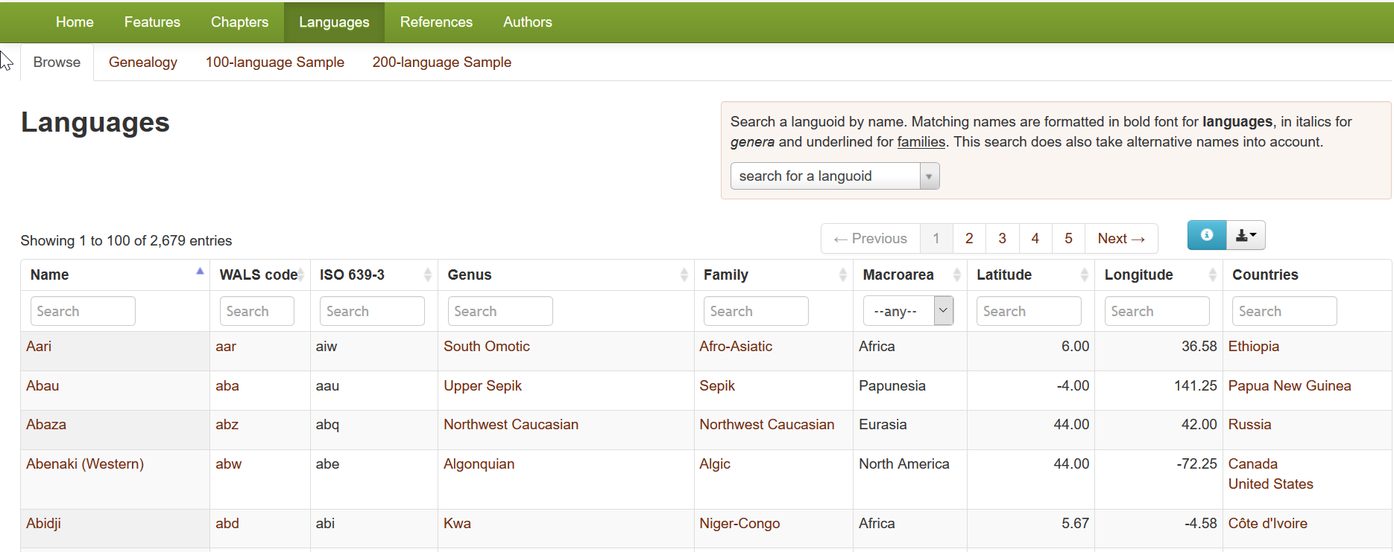
The data source, and “why” the study
WALS-Dataset
The World Atlas of Language Structures dataset, herein after referred to as “WALS,” can be accessed via the world wide web at the following address: https://wals.info/. The Dataset can be obtained from the website in the form of a comma separated value file and geojson. The researcher brought in the .csv and geojson into the local environment of Jupyter notebooks for further data exploratory analysis utilizing the Python 3 programming language.
WALS Online, is a database of structural (phonological, grammatical, lexical) properties of languages gather from descriptive materials, from around the world. First release by Oxford University Press as a book with CD-ROM in 2005, it was released in a second addition on the internet in April 2008. The database is maintained by the Max Planck Institute for Evolutionary Anthropology.

Slide 4
The “why”
Personal interest in the anthropological study of the Indo-European language and invasion history. (colonization of the new world was just one of the many Indo-European invasions)
In my formidable years, I was a Latin scholar; with a fascination of/for India.
Pater / Pitar connection
The connection was noted by early European visitors to India in 17th century
Sir William Jones the philologist known today for making and propagating the observation about relationships between the Indo-European languages. In his “Third Anniversary Discourse”, to the Asiatic Society (1786), he suggested that Sanskrit, Greek, and Latin languages had a common root, and that indeed they may all be further related, in turn, to Gothic and the Celtic languages, as well as to Persian
Quote ->

Slide 5
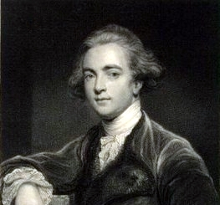
The “why”
“The Sanscrit language, whatever be its antiquity, is of a wonderful structure; more perfect than the Greek, more copious than the Latin, and more exquisitely refined than either, yet bearing to both of them a stronger affinity, both in the roots of verbs and the forms of grammar, than could possibly have been produced by accident; so strong indeed, that no philologer could examine them all three, without believing them to have sprung from some common source, which, perhaps, no longer exists; there is a similar reason, though not quite so forcible, for supposing that both the Gothic and the Celtic, though blended with a very different idiom, had the same origin with the Sanscrit; and the old Persian might be added to the same family.”
Sir William Jones FRS FRSE (28 September 1746 – 27 April 1794)

Slide 6
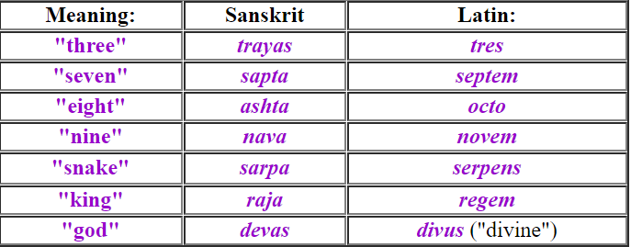
Consider the following:

Slide 7
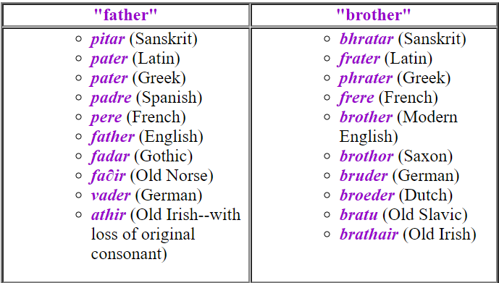
Consider the following:
Sanskrit
Latin
Greek
Spanish
French
English
Gothic (proto-Slavic Germanic)
Old Norse
German(s)
Gaelic
Examples of change:
Latin – dentist
German – tooth
German dialects change d for t in pronunciation (a major split)

Slide 8
English is a HYBRID of the: Latin: t usage “tres” German: d usage “drei” English Hybrid: “Three”
tres
Get to the programming …

Slide 9
JUPITER ---- IS EVEN INDO EUROPEAN
JU – SKY
PITER – FATHER

Slide 10
JUPYTER
JU – SKY
PYTER – NOTEBOOK =)

Slide 11
Analysis Questions
Using Jupyter Notebooks Python3 to find the story in the WALS dataset

Slide 12
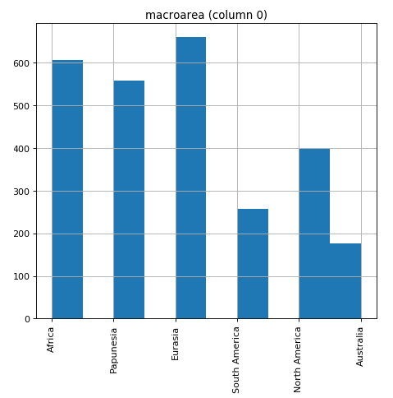
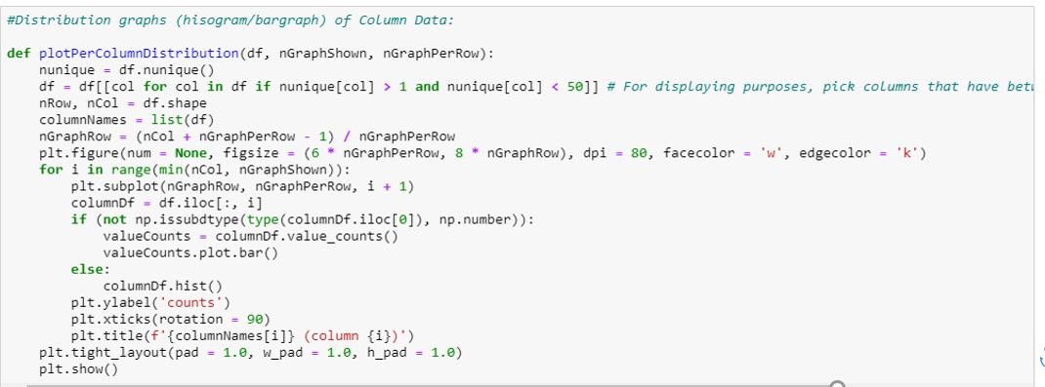
Analysis Question I: What is the frequency distribution of the languages; determinate upon their macroarea?
Coding

Slide 13
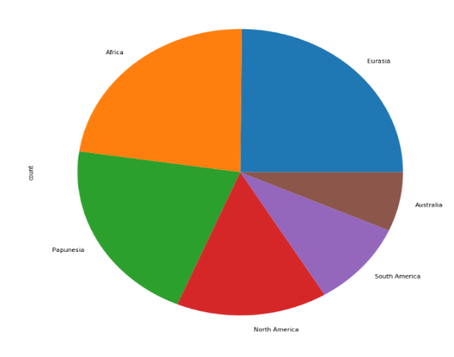
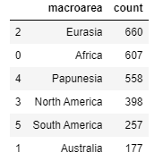
Analysis Question I: What is the frequency distribution of the languages; determinate upon their macroarea (cont.)?

Slide 14
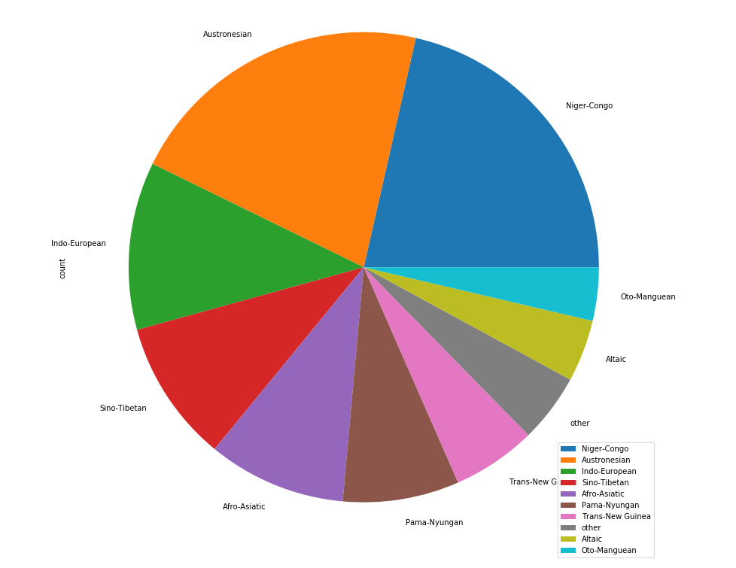
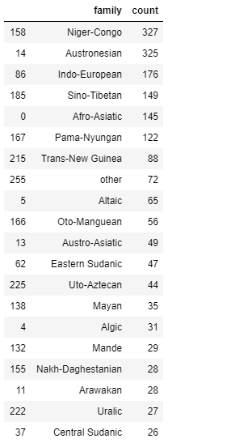
Analysis Question II: What are the major language families counts of each respective individual languages' family?

Slide 15
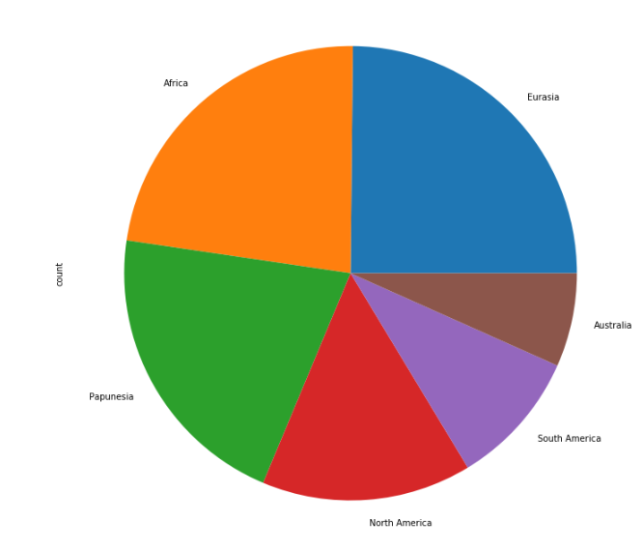
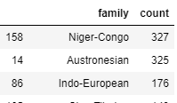
Analysis Question III: Can a geographic spatial analysis of the top three language families be identified from the data?

Slide 16
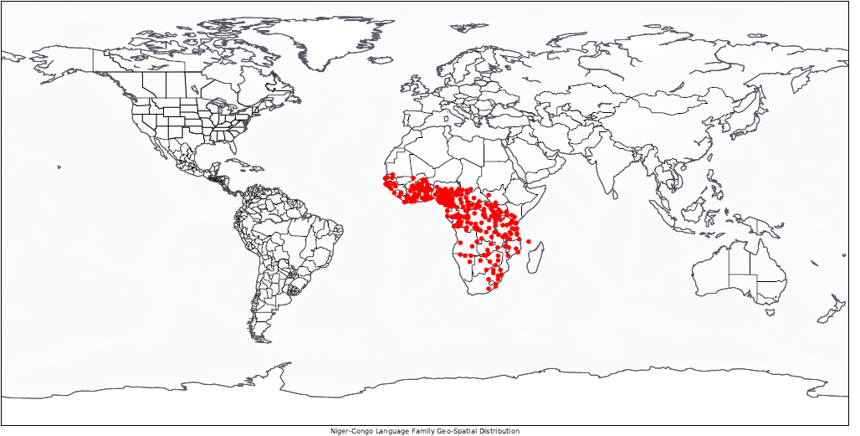
Analysis Question III: Can a geographic spatial analysis of the top three language families be identified from the data?
No.1 Niger-Congo Language Family:
Geographic distribution is found throughout Africa; it is the worlds third largest spoken language family, however, per the dataset, is first in the counts of individual language members to the respective language family. The Niger-Congo Language Family is first, in total individual members to their language family, which is intuitive, humans evolved within the Africa continent.

Slide 17
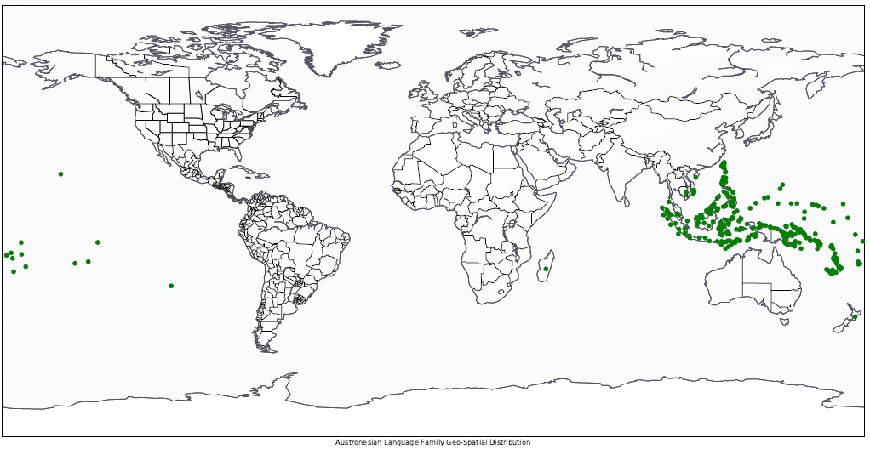
Analysis Question III: Can a geographic spatial analysis of the top three language families be identified from the data?
(take note of Madagascar / New Zealand ~ interesting observational outliers)
No.2 Austronesian Language Family
Geographic distribution is found throughout: Taiwan, the Malay Peninsula, Maritime Southeast Asia, Madagascar, and the islands of the Pacific Ocean. It is the fifth-largest largest spoken language family, however, per the dataset, it is second in terms of the counts of individual language members to the respective language family. The numbers of individual languages to this language family follow close in-line with the Niger-Congo language family, which can also be seen as intuitive and interesting for the following reasons: the geographic area that this language family is distributed through is massive, thus, allowing for distance and time to create sub-dialects of the proto-language family inheritance, AND, as the first waves of human migration (DNA haplogroups F – Forward) initiated along the very migration pattern demonstrated by the languages geospatial analysis

Slide 18
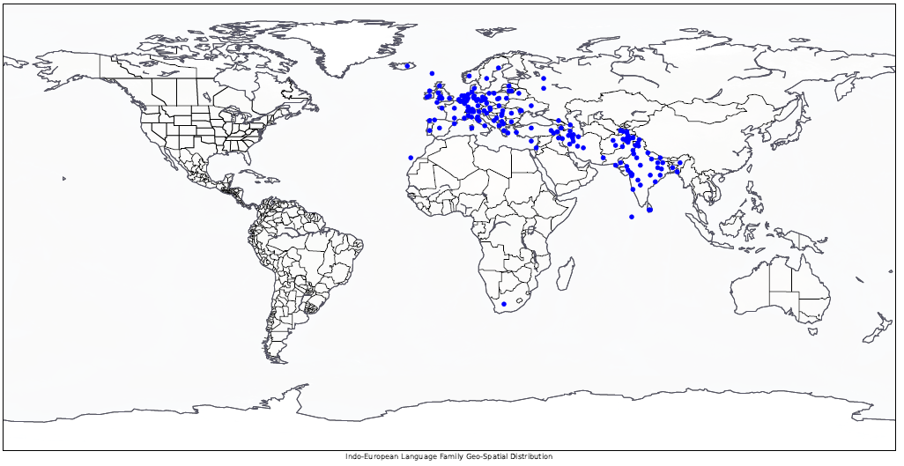
Analysis Question III: Can a geographic spatial analysis of the top three language families be identified from the data?
(take note of the Canary Islands ~ interesting outlier)
No.3 Indo-European Language Family
Geographic distribution is found throughout:
Western Eurasia compromising most of the languages of Europe together with those of the Indian Subcontinent (mostly in the northern portions of the subcontinent) and the Iranian Plateau. It is the second-largest spoken language family, however, per the dataset, it is third in terms of the counts of individual language members to the respective language family. The Language families ‘linguistic homeland,’ is in dispute, but given the nature of similarities found throughout Latin and Sanskrit and their respective language subdivisions, anthropologist, linguist, and, archeologist are beginning to determine that the ‘linguistic homeland,’ of the ancient proto-Indo-European language family to be found in the Caucus regions of southern Russia, therein radiating out westerly, and southernly through the passes of the Hindu Kush, into Northern India

Slide 19
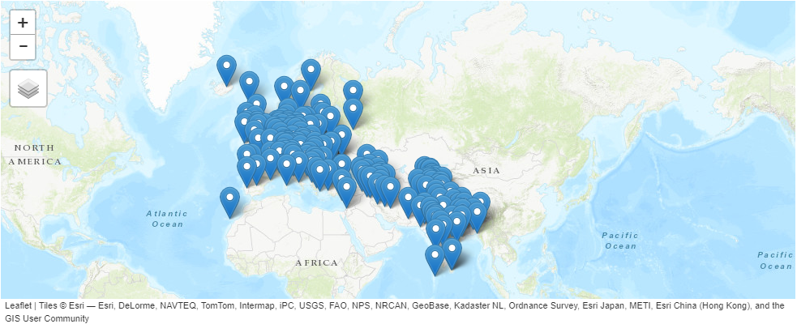
Analysis Question III: Can a geographic spatial analysis of the top three language families be identified from the data?

Slide 20
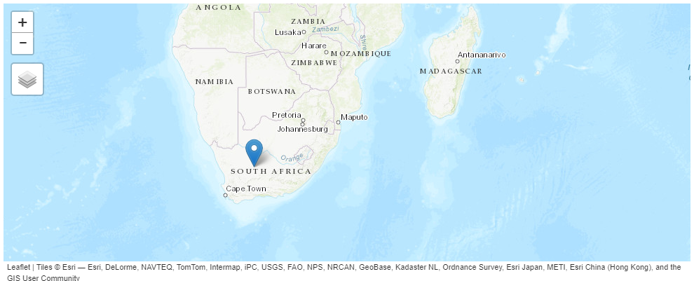
Interesting observation; the vestige of one of the last Indo-European invasions: Afrikaans

Slide 21
Conclusions that have been drawn from the dataset
From the dataset obtained, via semi-structured data and structured data, the research project was able to identify the frequency distribution of each language, determinate upon their macroarea, and the researcher was able to demonstrate the shape and size of that data. The research project was also able to identify the major language families counts of each respective individual language’s family subdivisions. Finally, the dataset provided for the ability to render a geospatial analysis of the data contained within the dataset, it allowed for the researcher to plot the language families on a geographic representation of the earth, whereby the distribution of the family of languages, per their language family could be demonstrated by static and interactive mappings
In so doing, the research projects conclusion are as follows: the top three language family’s totals are intuitive, given the historical, anthropological, and archeological studies that have been conducted, throughout the 19th, 20th, and 21st century. The language families, along with their specific subdivision can be visually demonstrated via geographic spatial analysis. The research projects goals of showing that distribution via the data, and expounding upon the researcher’s native spoken language family, the Indo-European language family specific geo spatial analysis was accomplished.

Slide 22

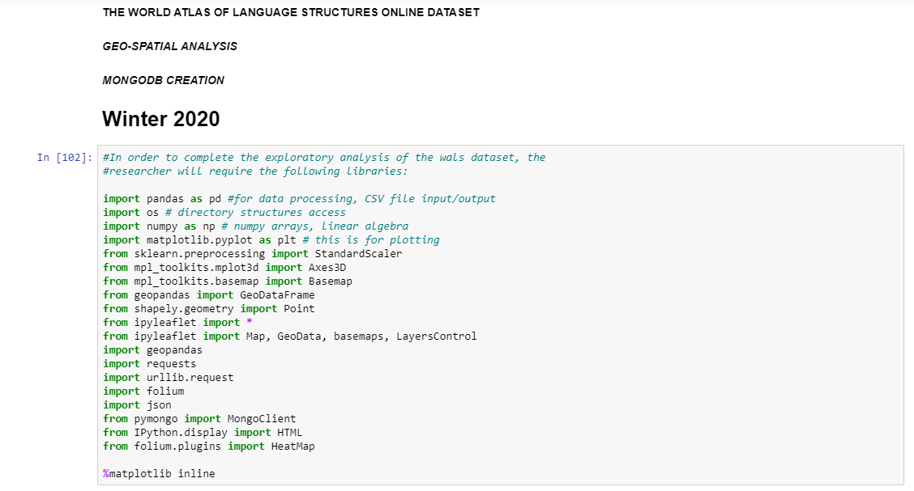
The Program

Slide 23
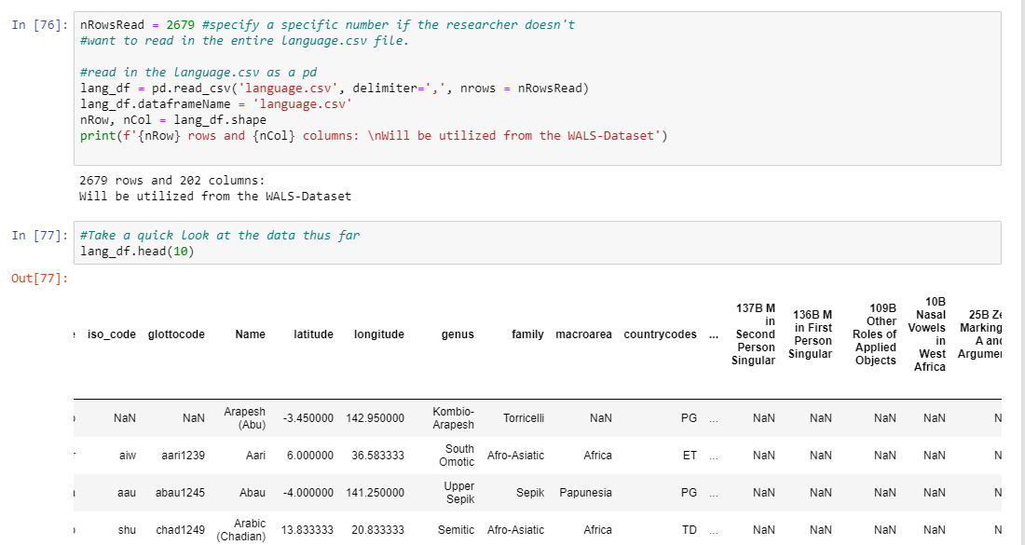
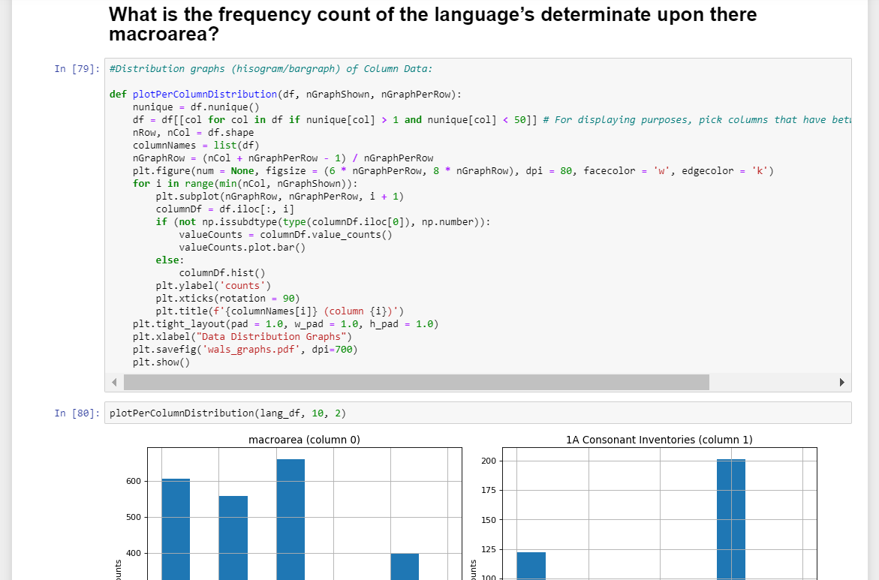
The Program

Slide 24
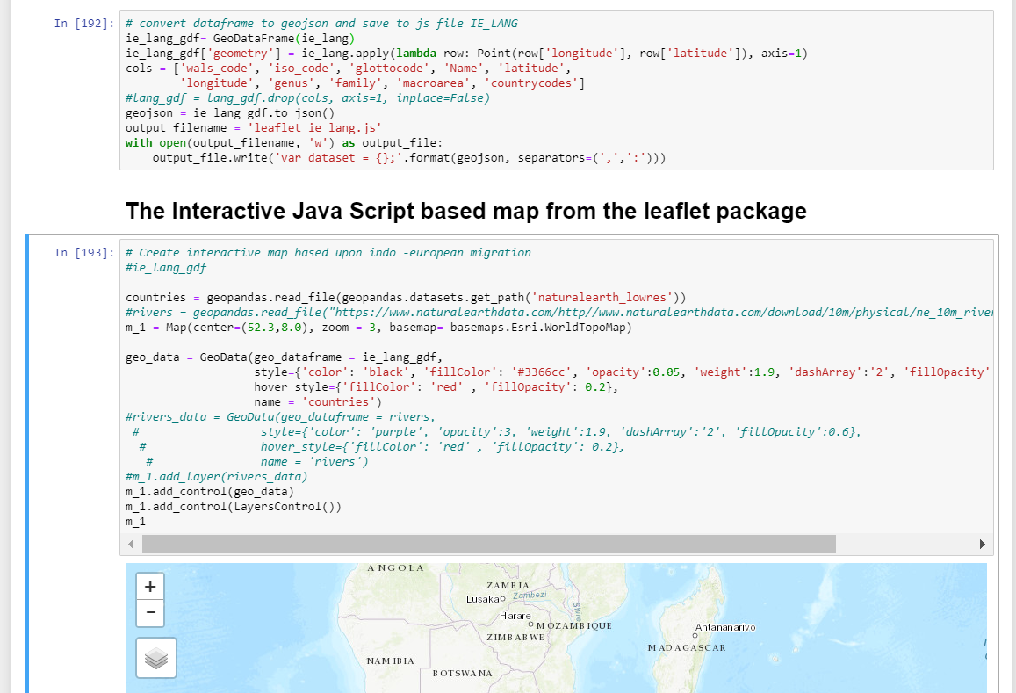
The Program

Slide 25
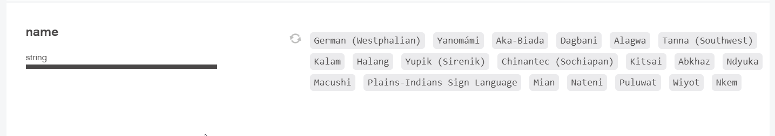
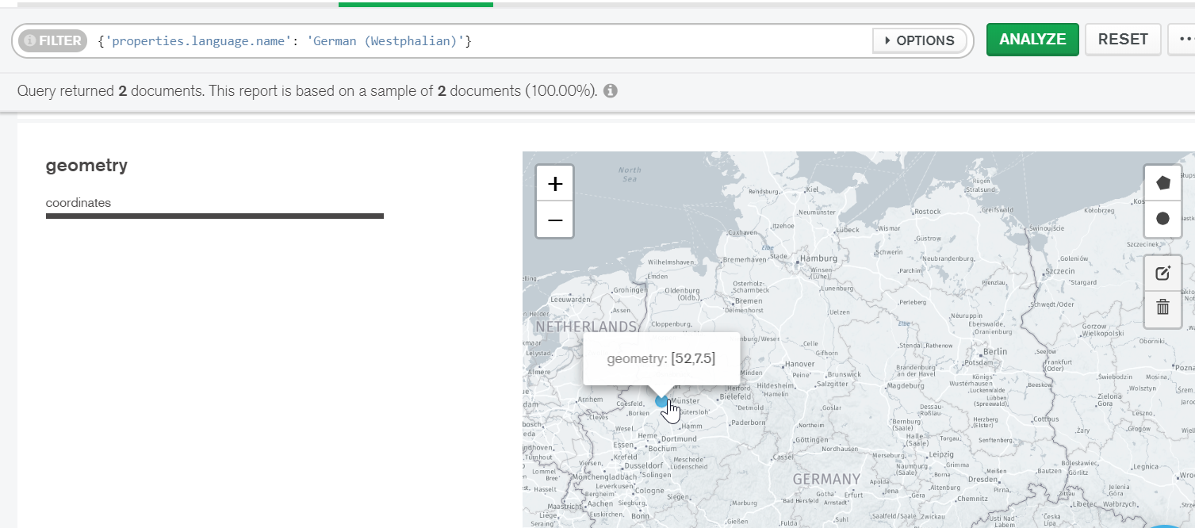
The Program
The geojson file having been converted into the MongoDB “Wals” MongoDB Compass demonstrated below:

Slide 26


Thank you! Randall Scott Taylor Winter 2020

